Slide 1


Accenture Innovation Challenge
Harness Generative AI to develop innovative solutions that boost business and societal growth

Slide 2


Team Details
TEAM NAME: InnovaAS
Sonali Bhanudas Mali
Akanksha Ramesh Solankurkar
College: D.Y Patil College of Engineering & Technology Kolhapur, Maharashtra, India
Stream: Computer Science & Engineering (AIML)
Year of graduation: 2026
College: D.Y Patil College of Engineering & Technology Kolhapur, Maharashtra, India
Stream: Computer Science & Engineering (AIML)
Year of graduation: 2026

Slide 3
Problem Statement
The Problem, Need & Solution -
In e-commerce businesses, developers and strategists face significant challenges when extracting actionable insights from large, complex datasets related to demand forecasting, inventory management, product optimization and customer engagement. They often rely on manual data analysis, which is both time-consuming and prone to error. Unstructured data, such as customer reviews and feedback, adds an additional layer of complexity, making it difficult to analyze customer sentiments and trends effectively. This process hinders productivity and delays critical decision-making, affecting overall business efficiency.
Our solution, InsightOptimizer, addresses these challenges by building a conversational interface that leverages Generative AI and advanced machine learning techniques. The system integrates a vector database to store and retrieve data sources and uses a Large Language Model (LLM) to process natural language queries. When developers insert a query into InsightOptimizer, the LLM processes it, retrieves relevant data, and provides meaningful insights tailored to the specific query. This approach allows developers to interact with data more seamlessly, reducing manual analysis, improving decision-making, and increasing productivity. By offering an intuitive interface that handles complex and unstructured data, InsightOptimizer streamlines operations and delivers valuable insights in real time. The system is scalable, making it feasible for businesses to implement and optimize their workflows.
What does it aims to solve?
It aims to solve several major challenges faced by developers in e-commerce businesses, specifically in areas like demand forecasting, inventory management, and customer engagement analysis including - Manual Analysis, Processing Unstructured Data, Lack of Real-Time Insights & Limited Personalization.
Target Audience –
Developers, Data Analysts, E-Commerce Strategists, Product Managers, Marketing Teams, Inventory Managers, Customer Support Teams, etc

Slide 4
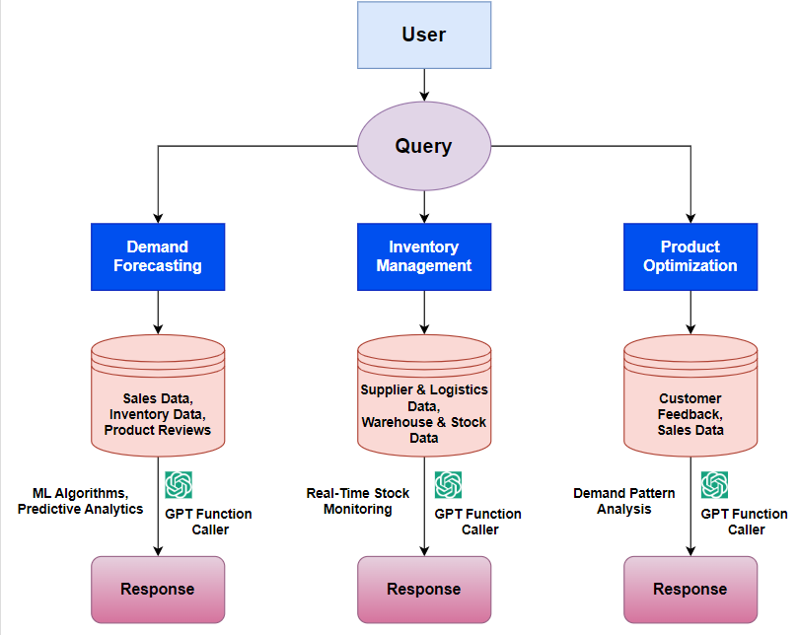
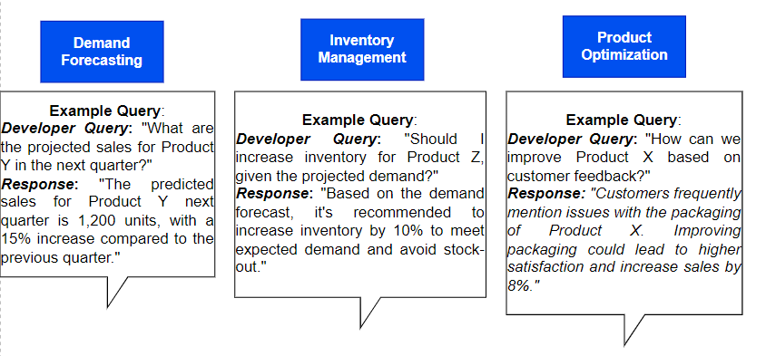
Proposed solution
User Input: A user submits a query related to Demand Forecasting, Inventory Management, or Product Optimization.
Data Storage:
The query triggers storage of various data types in a Vector Database, including:
Sales Data
Inventory Data
Product Reviews
Supplier & Logistics Data
Warehouse & Stock Data
Demand Forecasting
Users query future product demand, and the system retrieves historical sales data from a vector database. By applying advanced forecasting algorithms and LLMs, it identifies trends and generates actionable insights. This streamlines decision-making for inventory and marketing strategies, enhancing productivity by reducing manual efforts.
Inventory Management
Users inquire about stock levels and supplier logistics. The system analyzes inventory data with LLMs to determine optimal stock levels based on sales trends. It provides tailored recommendations, helping businesses maintain adequate inventory and minimizing risks of stock-outs or overstocking, thus improving operational efficiency through automation.
Product Optimization
Users seek ways to enhance product offerings. The system collects customer feedback and sales data, utilizing NLP and LLMs for sentiment analysis. Insights gained help businesses refine product strategies, increasing customer satisfaction and engagement while optimizing resource allocation, leading to greater operational efficiency.
Workflow -

Slide 5
How does our innovation accelerate change with the power of Technology?
Accurate Demand Forecasting: Uses advanced ML algorithms and Gen AI-generated simulations to improve the accuracy of demand predictions, minimizing stock-outs and overstock situations.
Rapid Insight Retrieval: Vector databases allow quick access to insights. ML algorithms continually learn from user interactions, enhancing the relevance of information retrieved.
Empowered Decision-Making: Leverages ML and Gen AI for rapid, data-driven decisions, enabling businesses to swiftly respond to market changes and customer demands.
Increased Inventory Efficiency: Integrates real-time data analytics to optimize inventory levels based on predicted demand, reducing carrying costs and improving product availability and profitability.
Increased Customer Engagement: By optimizing products based on customer preferences, businesses can increase engagement, enhance satisfaction, and foster loyalty.
Transformative Technology Integration: Combines Generative AI, Machine Learning (ML), Natural Language Processing (NLP), and Large Language Models (LLMs) to enhance demand forecasting, inventory management, and customer engagement.
Increased Profitability: Better product availability enhances customer satisfaction and loyalty, leading to increased sales. Insights from Gen AI inform pricing and promotional strategies.
Streamlined Operations: Intelligent tools optimize workflows and enhance operational efficiency, with ML identifying bottlenecks and suggesting improvements.
Sustainable Competitive Advantage: Enhances customer experiences and operational agility, positioning businesses to thrive and effectively respond to market challenges.
Fostering Continuous Innovation: Equips companies with tools to adapt to market dynamics, using Gen AI for rapid prototyping of new ideas.
Technology Stack –
Frontend – HTML, CSS, React.js, Material-UI
Backend – Node.js, Python (Django)
Vector Database – Pinecone
LLM’s – GPT -3.5
AI/ML – TensorFlow, LangChain, FastAPI

Slide 6
Impact & Novelty
Generative AI effectively addresses challenges like inaccurate demand forecasting and inefficient inventory management, streamlining operations and reducing errors.
Enhanced demand forecasting, driven by rapid queries from Large Language Models (LLMs), ensures optimal inventory levels, reducing stock-outs and overstock, leading to better product availability and profitability.
Leveraging vector databases allows for efficient storage and retrieval of high-dimensional data, enabling quick indexing and similarity searches. Integrating Large Language Models (LLMs) facilitates natural language queries and contextual understanding, improving data interaction.
Machine Learning algorithms analyze historical data to forecast future trends, enhancing decision-making and operational strategies. This combination allows for real-time data processing and insights, enabling agile responses to market changes.
Generative AI extracts valuable insights from large datasets, enabling informed decision-making and proactive responses to market changes.
Aims to automate routine tasks with Generative AI, boosting employee productivity and satisfaction, which leads to significant improvements within organizations.
Impact Metrics & Scalability –
Sales Growth - Demand forecasting, inventory management, product availability, increased revenue.
Operational Efficiency - Automation, real-time retrieval, productivity enhancement, cost reduction.
Rapid Data Analysis & Information Retrieval - Vector databases, LLM’s, natural language processing, actionable insights, agile decision-making.
Scalability: Flexibility, market expansion, adaptable architecture, growth potential.
PATENT FILED: No
Do you have a working model/prototype: No
If not, will you be able to show working prototype during finale. Yes

Slide 7
Testimonials Received

Slide 8
Video Explanation

Slide 9
Thank you!

